Slide 1

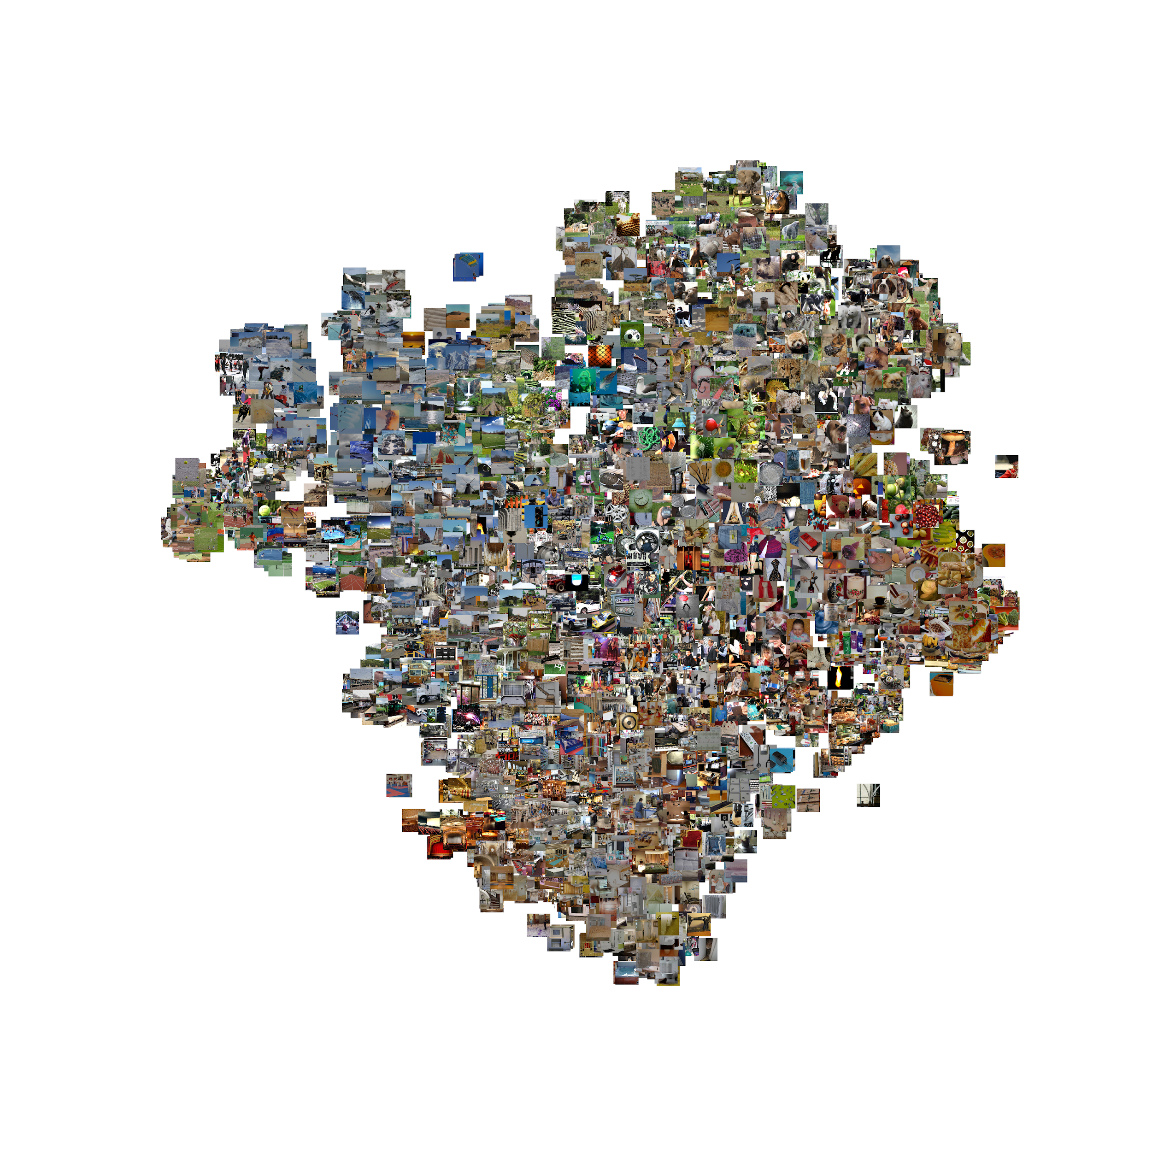
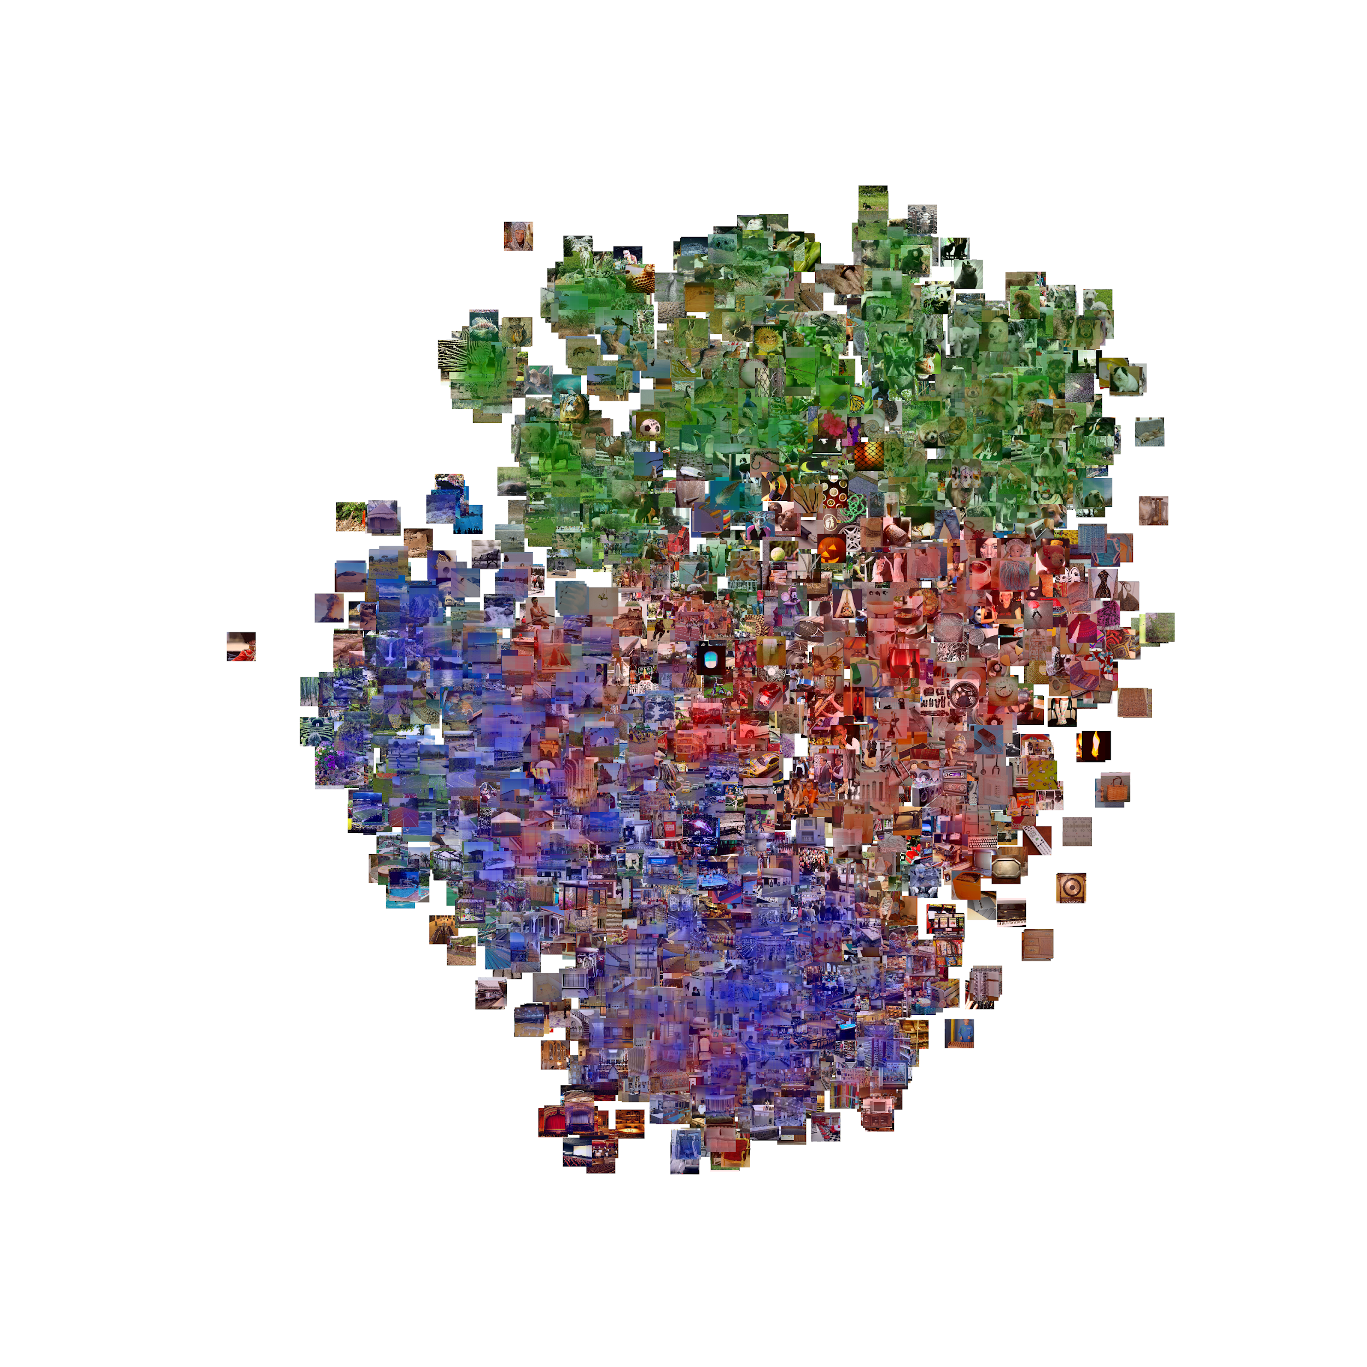
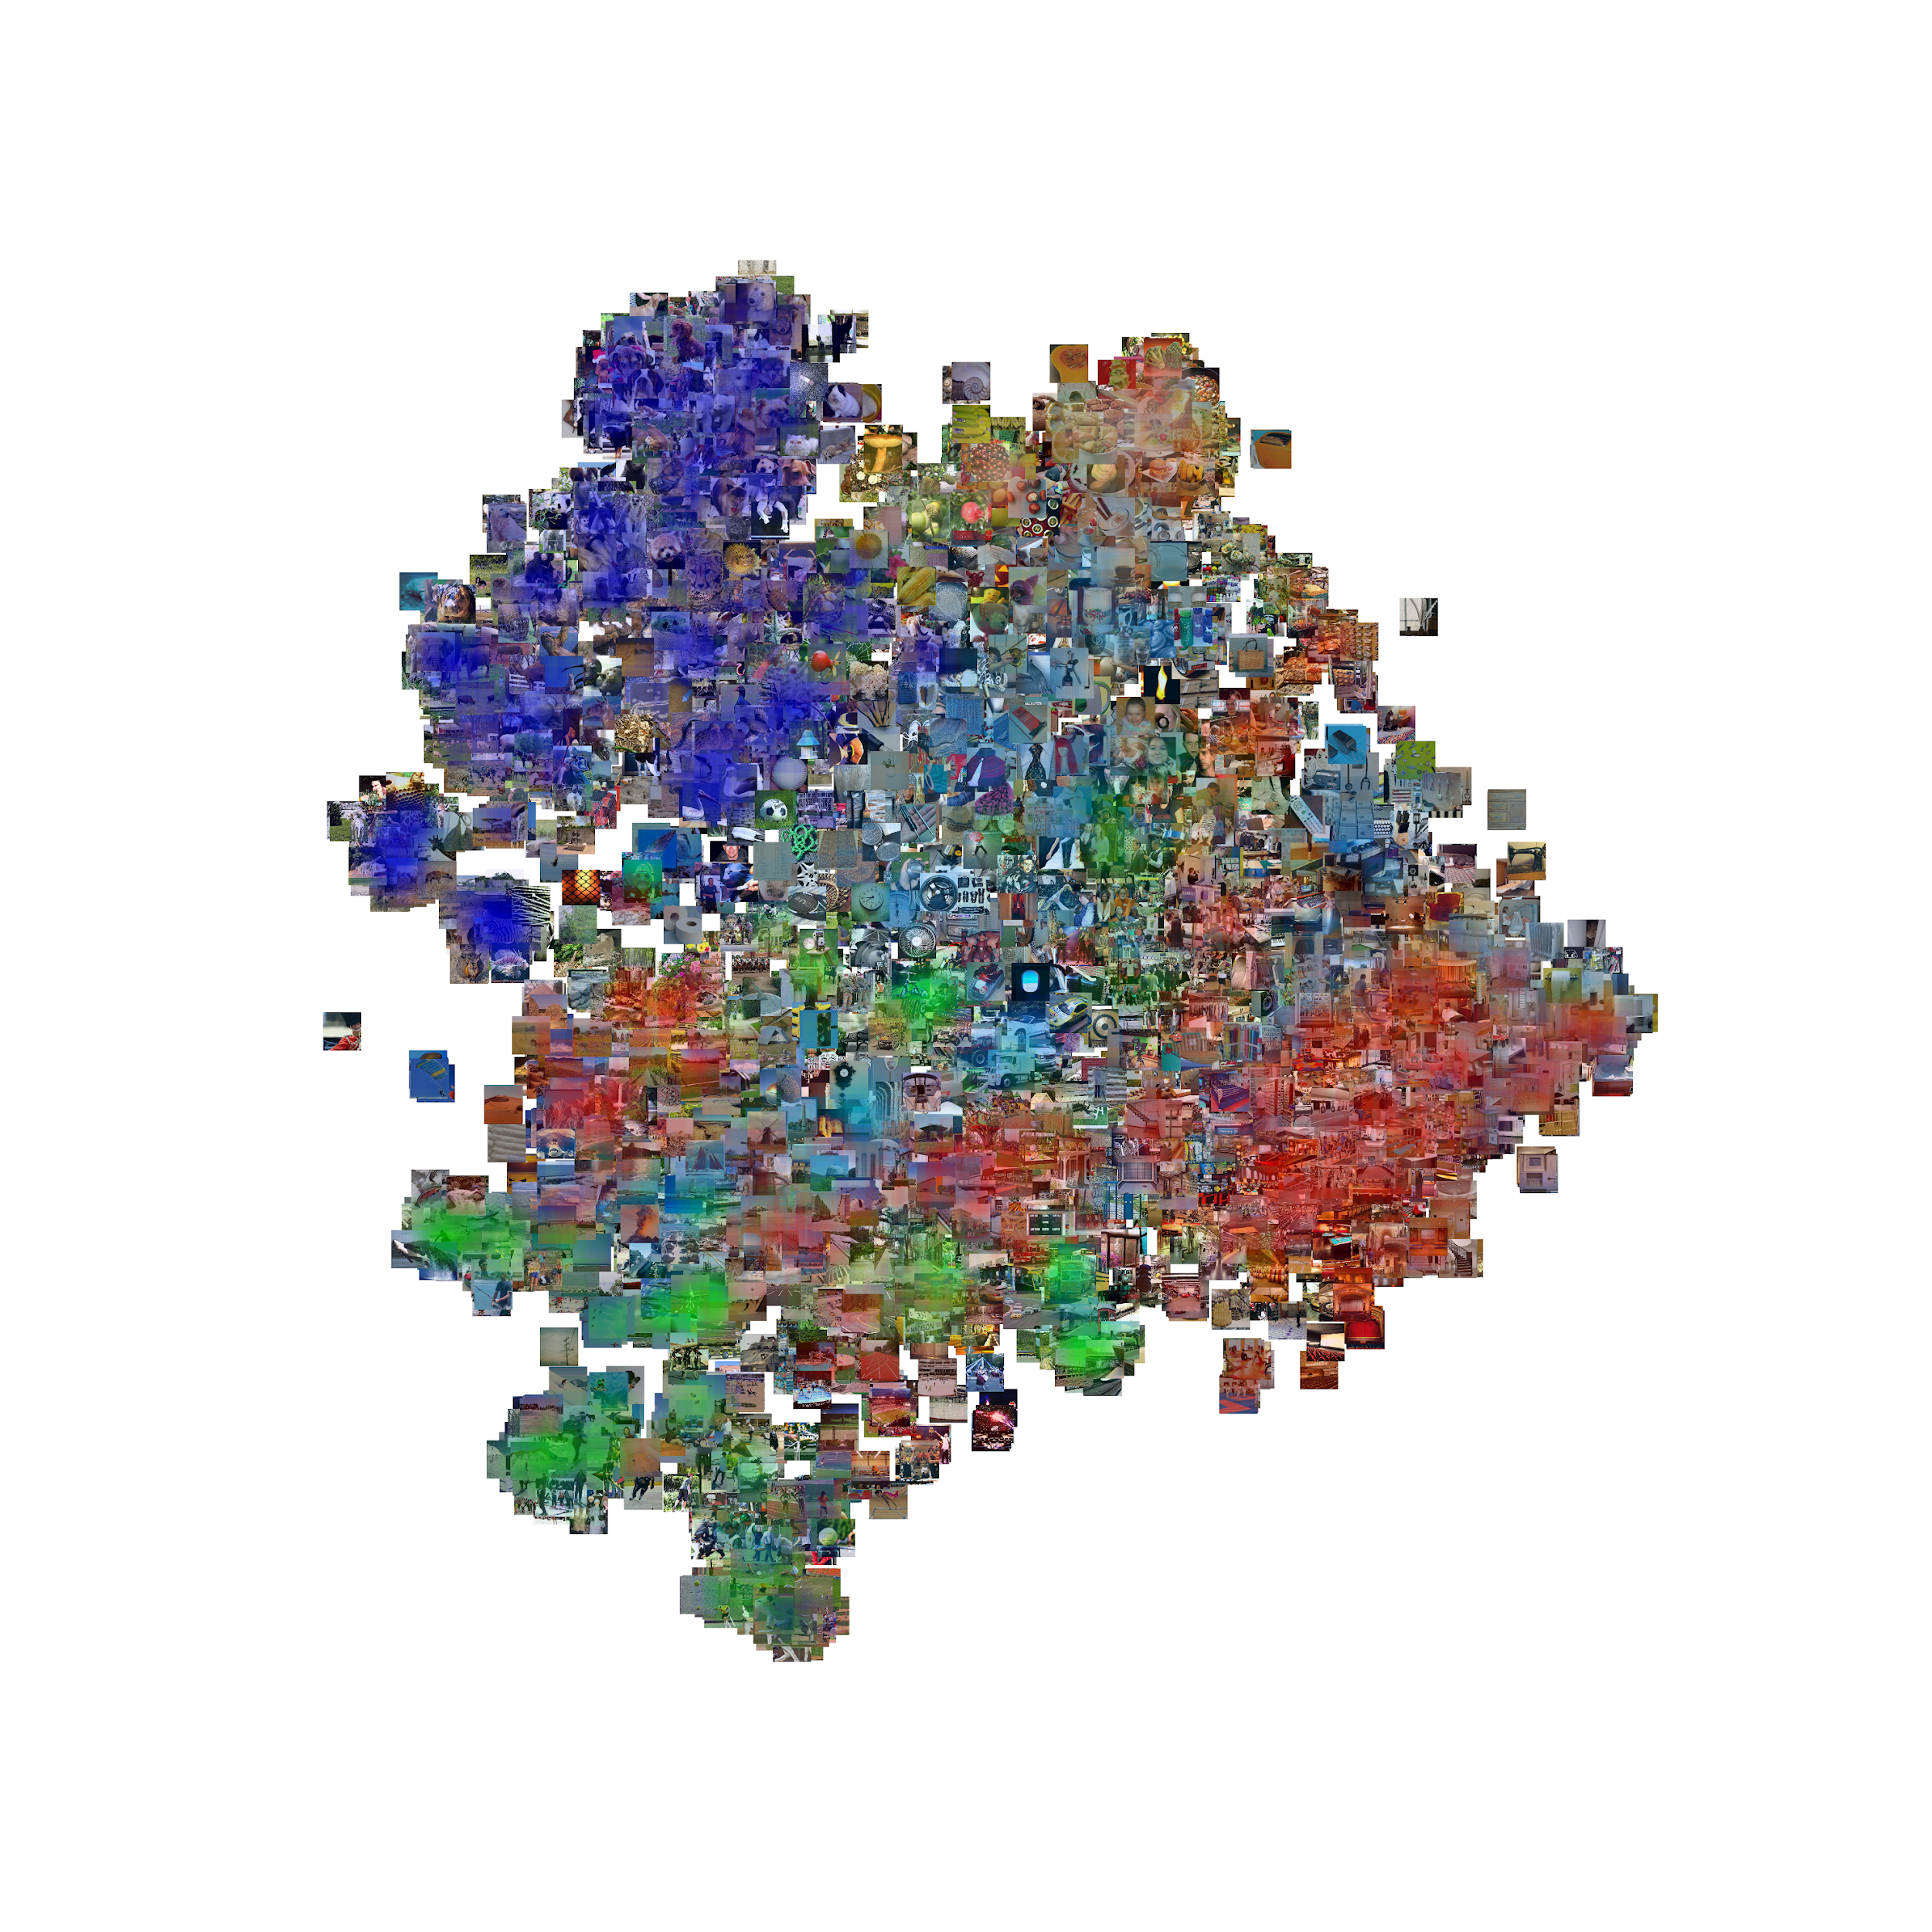
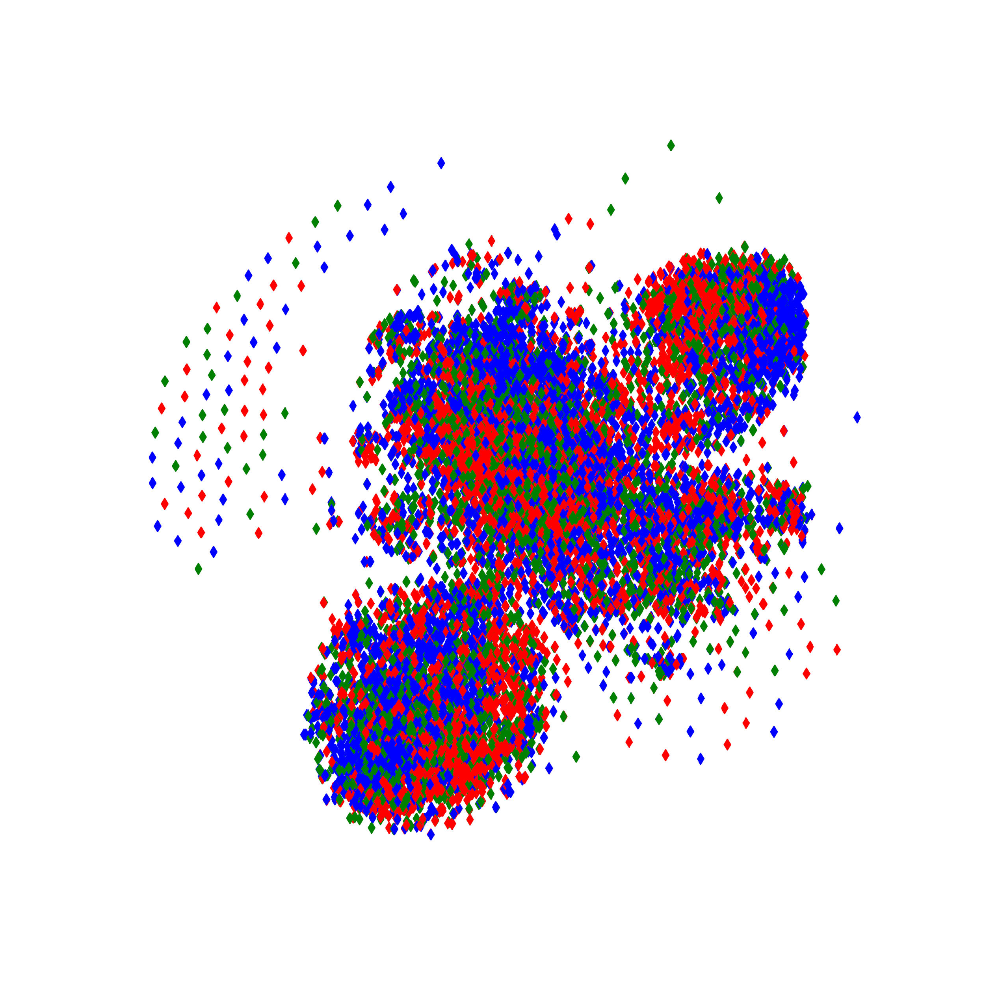
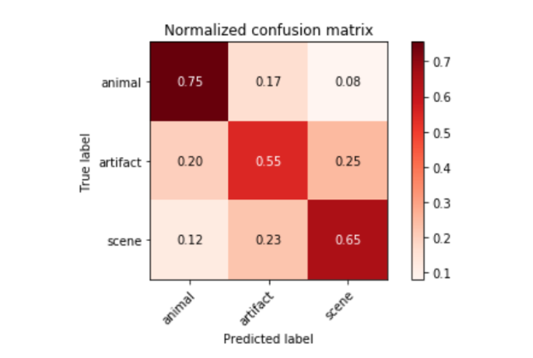
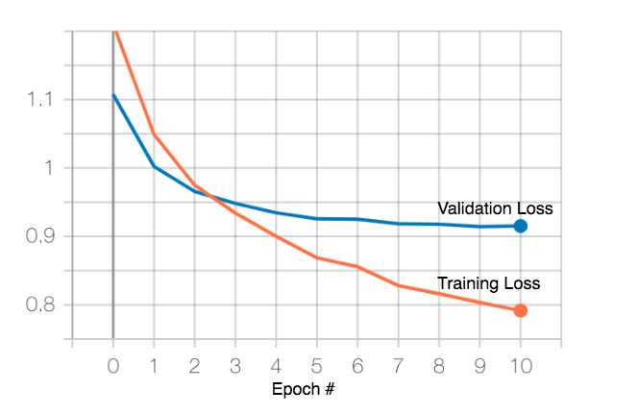
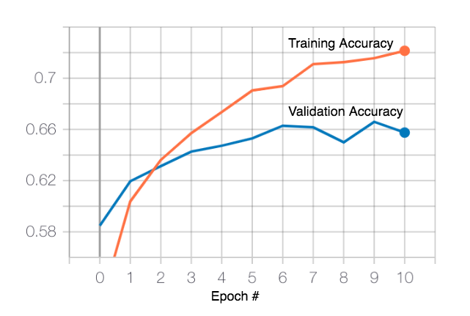
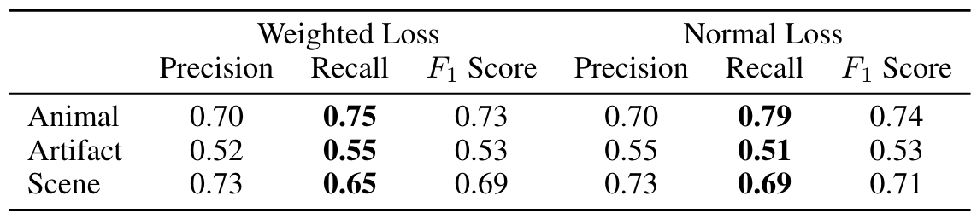
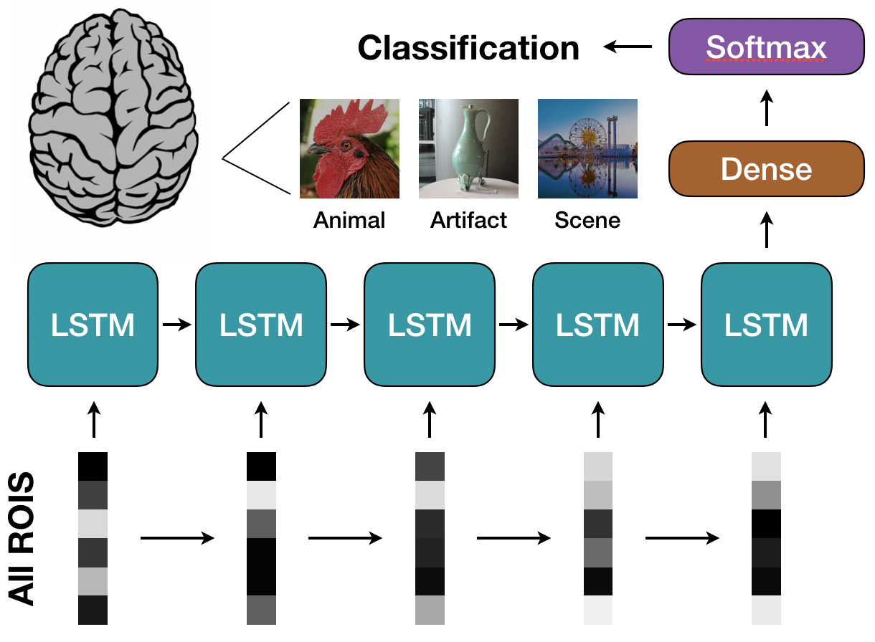
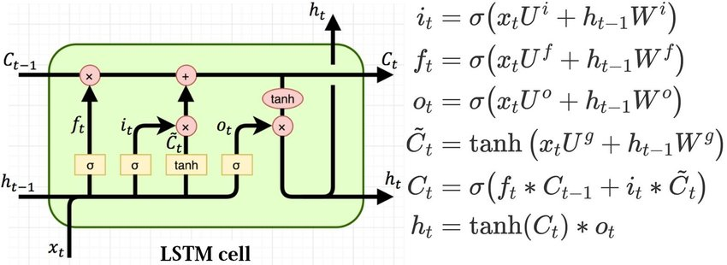
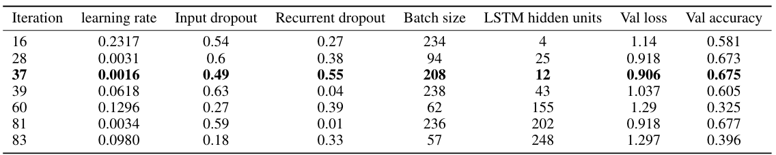
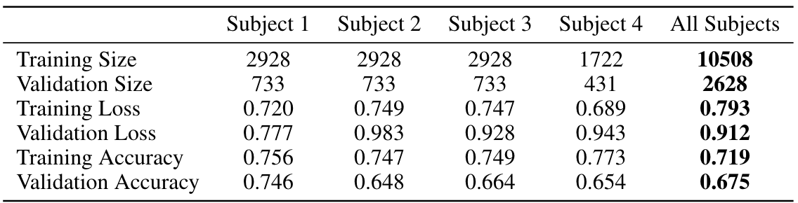
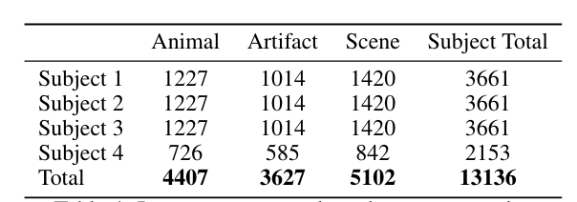
Categorization of seen images from brain activity using sequence models
Arash Jamalian, Rafi Ayub, Faraz Fadavi
{arashj, rafiayub, fadavi} @stanford.edu
Motivation
Results and Discussion
Background
The human visual system is incredibly complex and is not yet fully understood how it can recognize objects.
For biologically-inspired deep learning models for visual recognition to continue to be successful, we must study the brain further.
Problem
Many studies have decoded object category from visual brain activity, but most do not incorporate temporal information of fMRI.
Approach
We apply an LSTM classifier to predict seen object category from the brain activity of visual areas using fMRI.
t-SNE
All images
Animal, Artifact, Scene
Multiple subcategories
fMRI data
Methods
Dataset
BOLD5000: 4 subjects were shown images from ImageNet, COCO, and Scene UNderstanding (SUN) in the scanner.
Images were labeled with three super categories: Animal, Artifact, Scene.
fMRI timeseries was extracted from visual areas: parahippocampal place area, retrosplenial complex, occipital place area, lateral occipital complex, and early visual area in each hemisphere, resulting in ten total ROIs per subject
13136 samples x 5 timepoints/TRs x 6960 total voxels
Results:
High noise levels in fMRI with small sample size require high dropout rate to prevent overfitting
Achieve 68% accuracy with 65% average F1 score.
Subjects have different distributions. Best performance on subject 1.
Best performance: Animal category, Worst performance: Artifact category.
LSTM equations
Future Directions
References
Acquiring more fMRI data from similar studies can help significantly reduce our overfitting
Combining an LSTM with a generator network or autoencoder can allow use to generate images from fMRI data directly
Nadine Chang et al. “BOLD5000, a public fMRI dataset while viewing 5000 visual images”. In: Scientific data 6.1 (2019), p. 49.
Tomoyasu Horikawa and Yukiyasu Kamitani. “Generic decoding of seen and imagined objects using hierarchical visual features”. In: Nature Communications 8.May (2017), pp. 1–15. ISSN: 20411723. DOI: 10.1038/ncomms15037. arXiv: 1510.06479. URL: http://dx.doi.org/10.1038/ncomms15037.
Kai Qiao et al. “Category Decoding of Visual Stimuli From Human Brain Activity Using a Bidirectional Recurrent Neural Network to Simulate Bidirectional Information Flows in Human Visual Cortices”. In: Frontiers in Neuroscience 13.July (2019), pp. 1–15. DOI: 10.3389/fnins.2019.00692.
Guohua Shen et al. “Deep image reconstruction from human brain activity”. In: PLoS Computational Biology 15.1 (2019), pp. 1–23. ISSN: 15537358. DOI: 10.1371/journal.pcbi.1006633.
Kuan Han et al. “Variational autoencoder: An unsupervised model for encoding and decoding fMRI activity in visual cortex”. In: NeuroImage 198.January 2018 (2019), pp. 125–136. ISSN: 10959572. DOI: 10.1016/j.neuroimage.2019.05.039.
Figure 1: LSTM classifier model. Dropout was including before the dense layer. The optimal model after hyperparameter tuning had an LSTM size of 12 units, dense 32, dropout of 49%, recurrent dropout of 55%, Adam optimizer with learning rate 0.0016, decay 0.001, and batch size of 208.
Table 1: Number of images from each class shown to each subjects.

